Slide 1
University Of Computer Studies (PYAY)
CS-3156
2024-2025 Academic Year
Group (12)
Supervised By Daw Aye Aye Theint

Slide 2

Movie website Management System
Here is where your presentation begins

Slide 3
Our Group
Ma Khin Thiri Mon PaKaPaTa-002135 Leader
Ma Hsu Myat Mon Kyaw PaKaPaTa-002148 Member
Mg Yair Marn PaKaPaTa-002129 Member
Mg Aung Phyo Myint PaKaPaTa-002111 Member

Slide 4
Contents
Abstract
Introduction
Objectives
Implementation
Conclusion
References

Slide 5
Abstract
Our movie website management system helps run a website where people can watch movies for free.
This system makes it easy to manage the website and the movies available on it.
It lets website managers(admin) upload new movies and organize them into categories, like comedy or action.
It helps keep track of people who use the website with things like signing up and logging in.
This website is written by using HTML,CSS and PHP languages.

Slide 6
Introduction
Our system is like the engine that powers these websites, making sure everything runs smoothly so you can enjoy your favorite movies without any hassle.
It helps the people who run the website and add new movies, sort them into different categories like action or comedy, and make sure they're easy to find when they want to watch them.
You can keep downloading Myanmar Subtitle movies for free.

Slide 7
Objectives
To make it simple for website managers to add, organize, and update the collection of movies available on the website.
To ensure that users have a smooth and hassle-free experience while browsing and watching movies on the website, without any interruptions or technical issues.
To help users find the movies they want to watch quickly and easily by offering search functionalities.

Slide 8

Implementation
Home Page

Slide 9
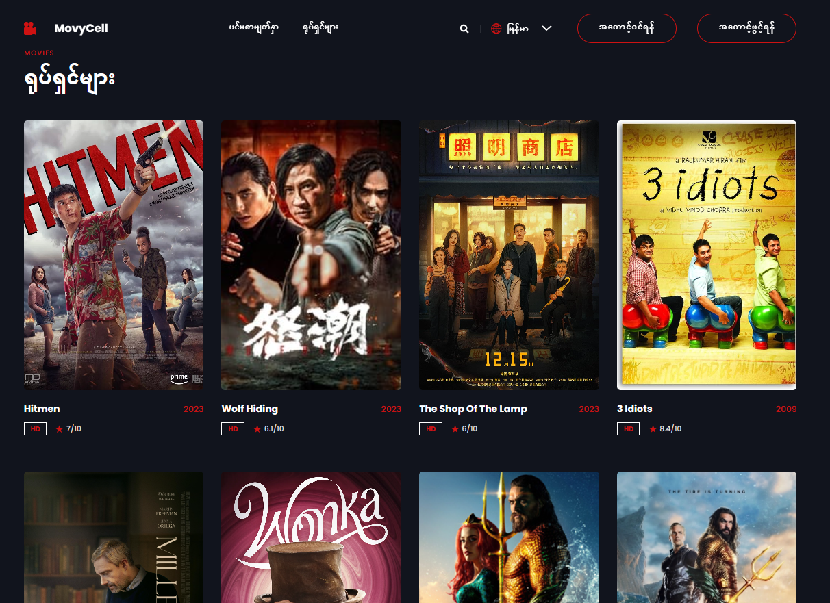
Movie Page

Slide 10
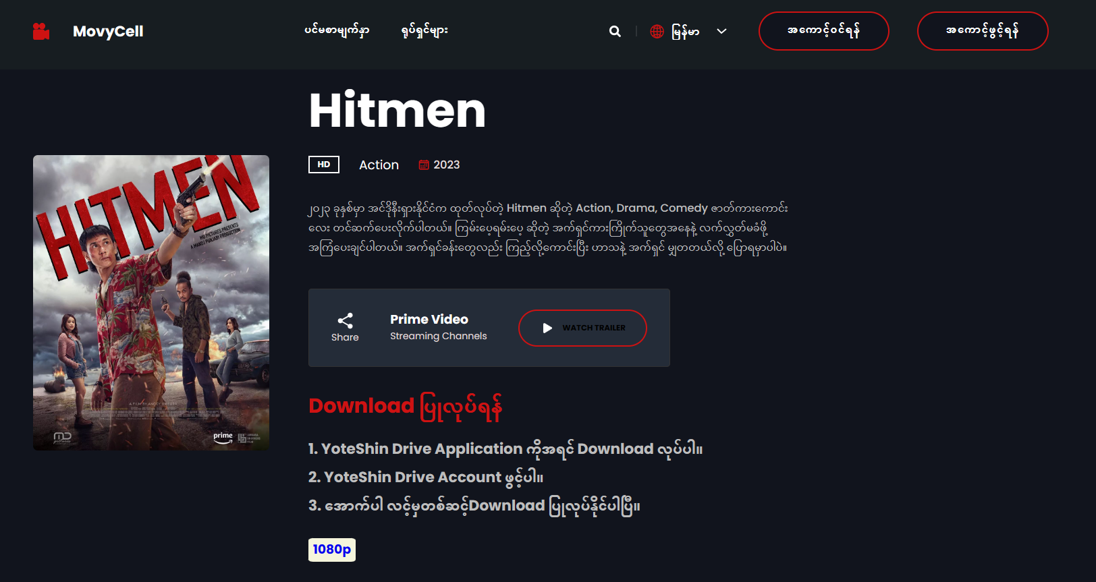
Movie Detail Page

Slide 11
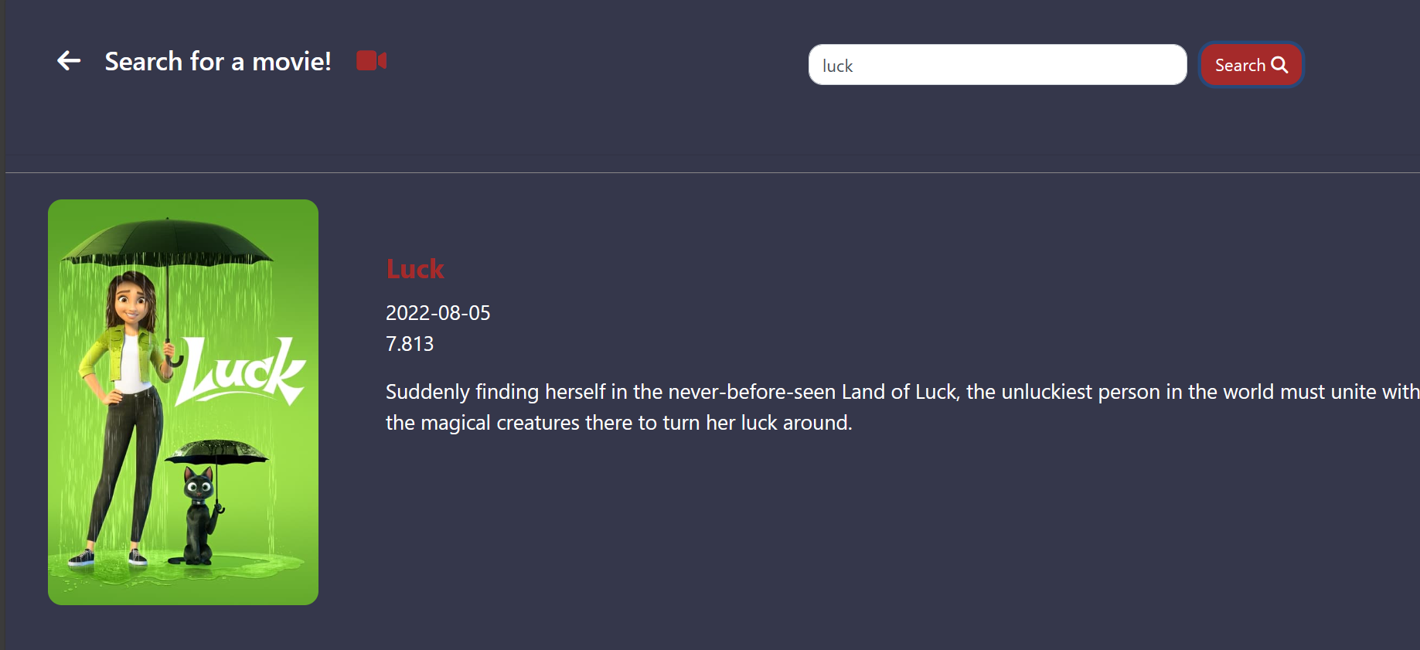
Search Page

Slide 12
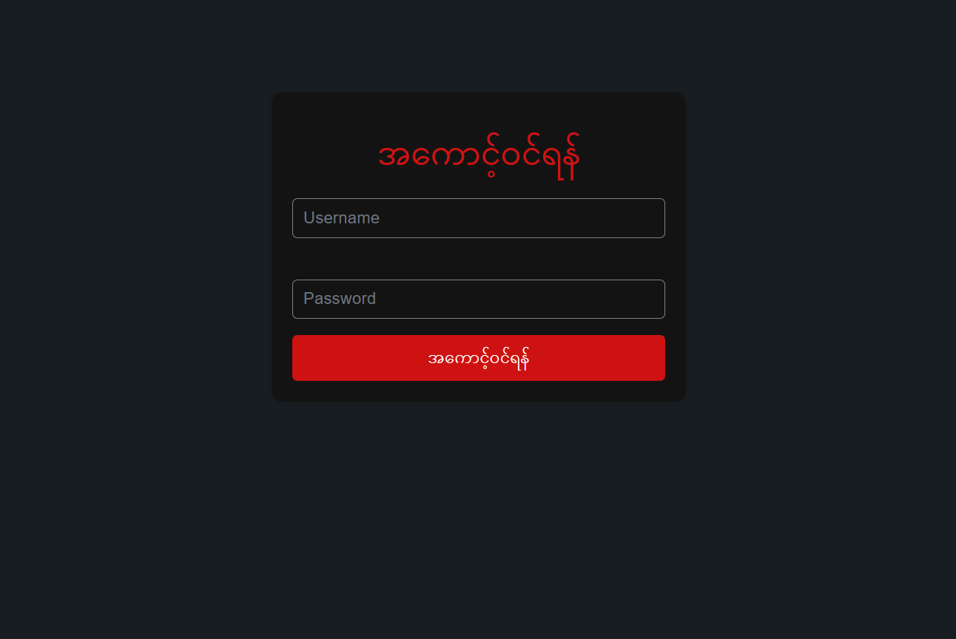
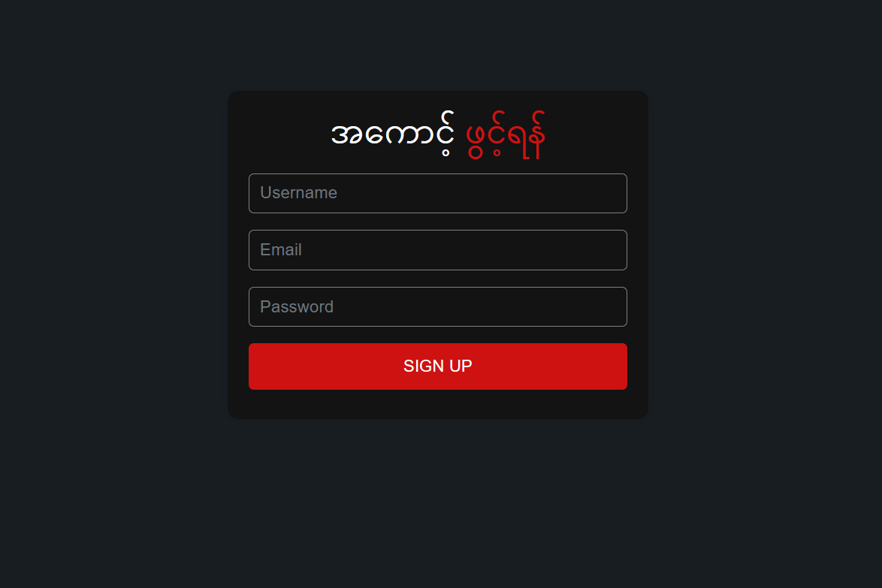
Login , Sign in Page

Slide 13
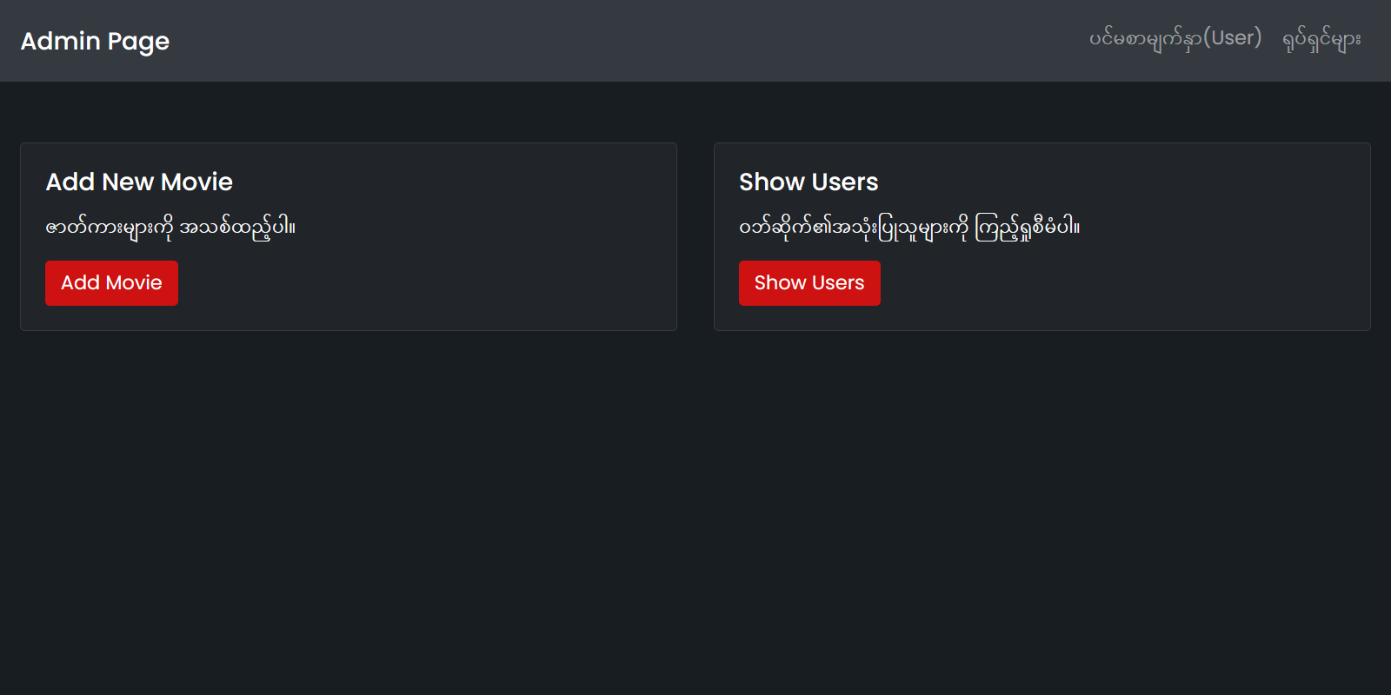
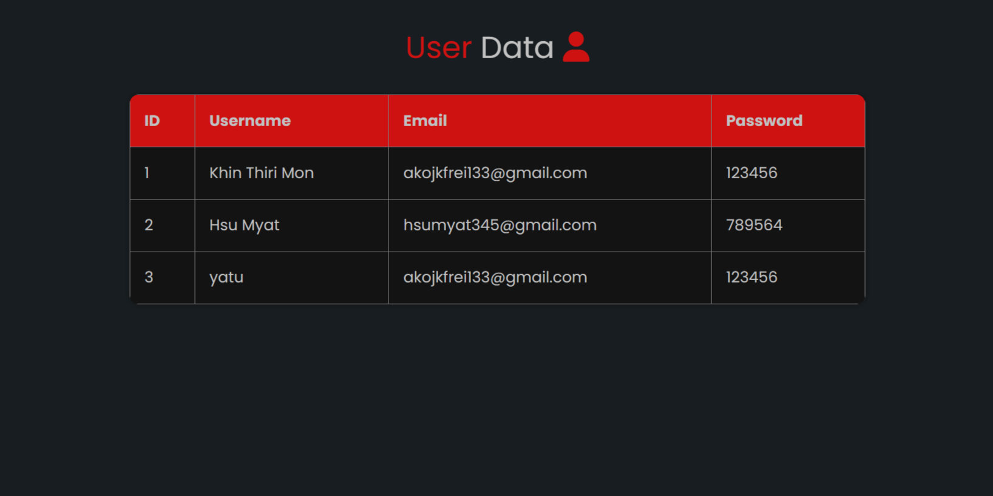
Admin Page

Slide 14
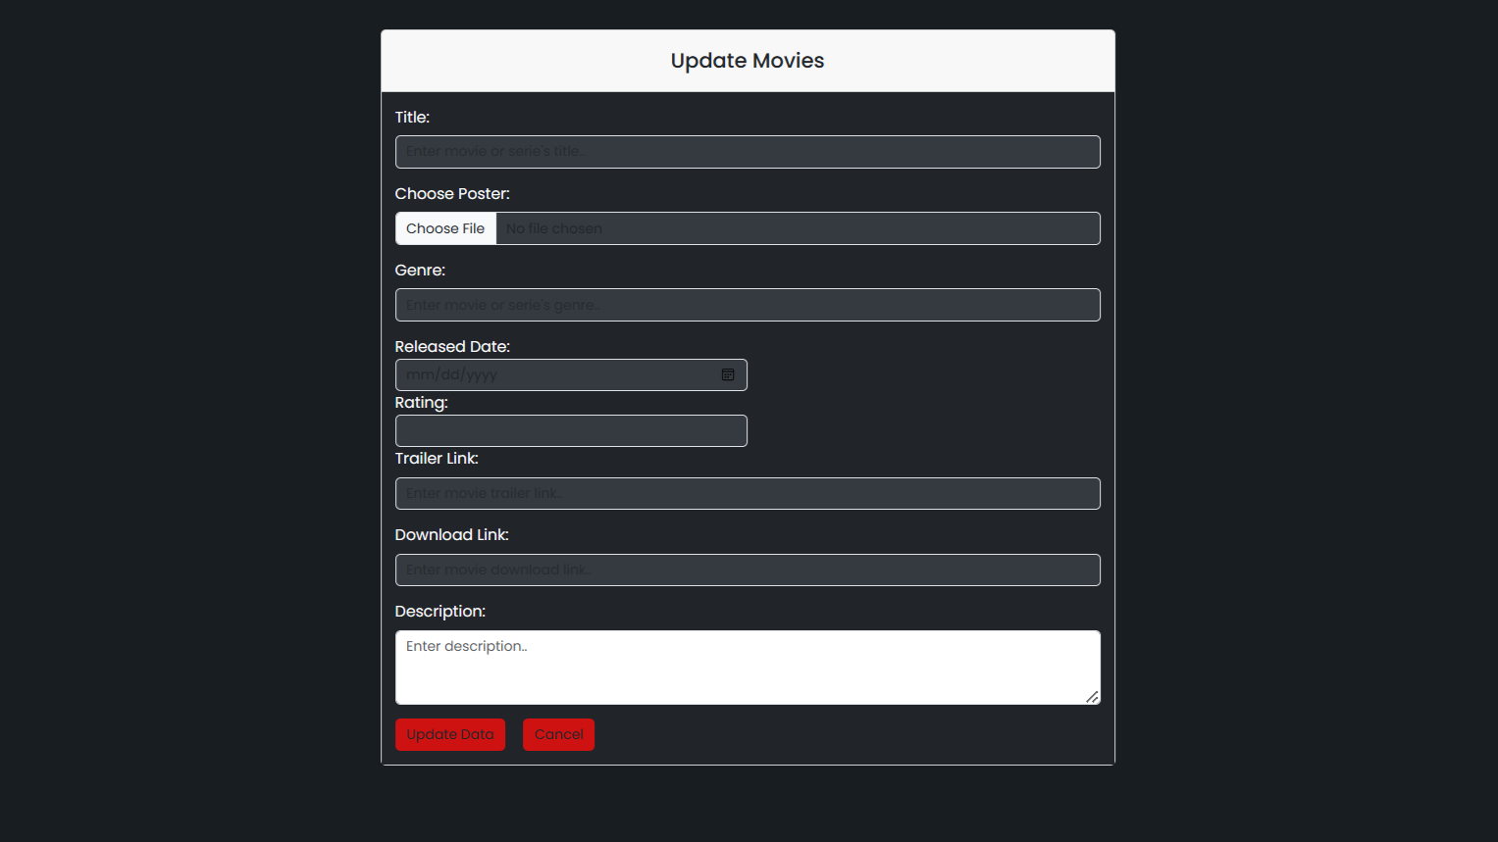
Movie Upload Page

Slide 15
Conclusion
Our system is a vital tool for ensuring that free movie website run smoothly and effectively.
It plays a crucial role in delivering an enjoyable movie-watching experience to users while supporting the sustainability of free movie websites.
It enables website owners to offer a valuable service to users by providing access to a wide range of movies for free download.
You can easily watch movie trailers and download them with Myanmar subtitles.

Slide 16
References
https://www.google.com
https://www.youtube.com
https://www.chatgpt.com
https://www.figma.com

Slide 17
Thank You!

